Slide 1

Problem Statement
As a data scientist at Microsoft, I was tasked with enhancing the efficiency of Security Operation Centers (SOCs) by developing a machine learning model that can accurately predict the triage grade of cybersecurity incidents. Utilizing the comprehensive GUIDE dataset, your goal is to create a classification model that categorizes incidents as true positive (TP), benign positive (BP), or false positive (FP) based on historical evidence and customer responses.
TP - A legitimate threat that is detected, BP - A legitimate activity or process that is sometimes mistaken for a malicious threat and FP - An alert that suggests a potential threat but is actually harmless
The model should be robust enough to support guided response systems in providing SOC analysts with precise, context-rich recommendations, ultimately improving the overall security posture of enterprise environments.

Slide 2
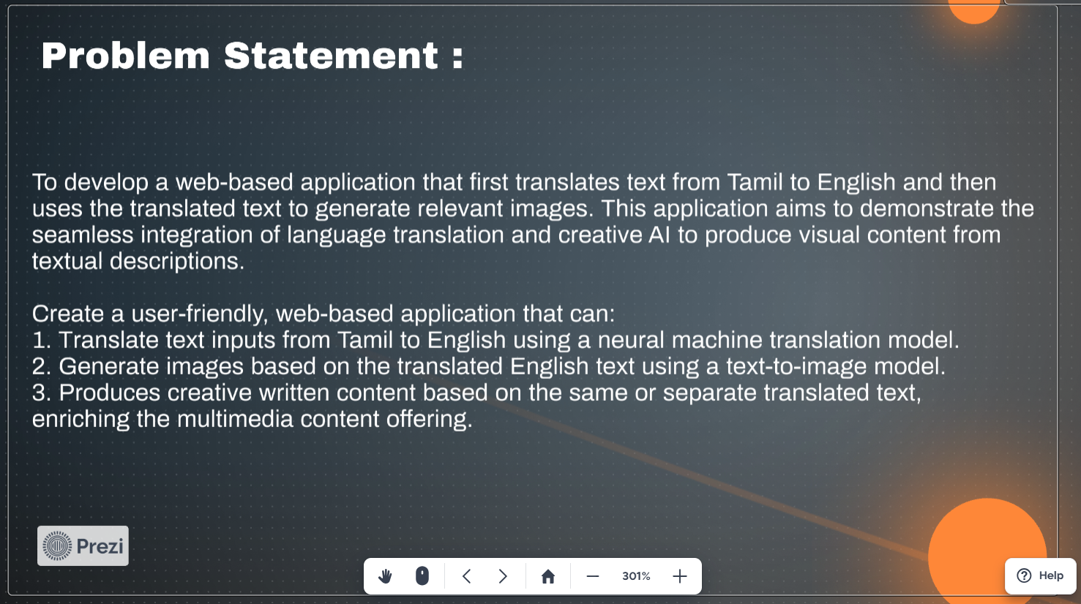
Problem Statement
As a data scientist at Microsoft, I was tasked with enhancing the efficiency of Security Operation Centers (SOCs) by developing a machine learning model that can accurately predict the triage grade of cybersecurity incidents. Utilizing the comprehensive GUIDE dataset, your goal is to create a classification model that categorizes incidents as true positive (TP), benign positive (BP), or false positive (FP) based on historical evidence and customer responses.
TP - A legitimate threat that is detected, BP - A legitimate activity or process that is sometimes mistaken for a malicious threat and FP - An alert that suggests a potential threat but is actually harmless
The model should be robust enough to support guided response systems in providing SOC analysts with precise, context-rich recommendations, ultimately improving the overall security posture of enterprise environments.

Slide 3
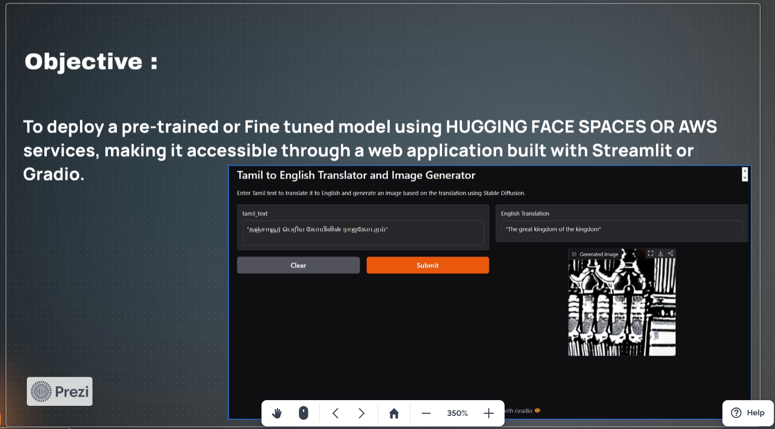
Problem Statement
As a data scientist at Microsoft, I was tasked with enhancing the efficiency of Security Operation Centers (SOCs) by developing a machine learning model that can accurately predict the triage grade of cybersecurity incidents. Utilizing the comprehensive GUIDE dataset, your goal is to create a classification model that categorizes incidents as true positive (TP), benign positive (BP), or false positive (FP) based on historical evidence and customer responses.
TP - A legitimate threat that is detected, BP - A legitimate activity or process that is sometimes mistaken for a malicious threat and FP - An alert that suggests a potential threat but is actually harmless
The model should be robust enough to support guided response systems in providing SOC analysts with precise, context-rich recommendations, ultimately improving the overall security posture of enterprise environments.

Slide 4
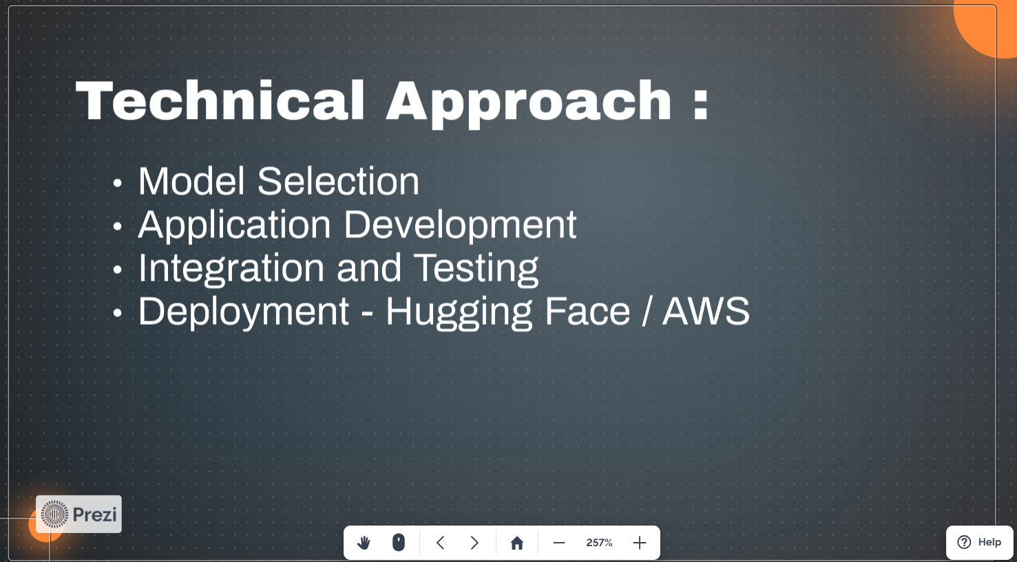
Problem Statement
As a data scientist at Microsoft, I was tasked with enhancing the efficiency of Security Operation Centers (SOCs) by developing a machine learning model that can accurately predict the triage grade of cybersecurity incidents. Utilizing the comprehensive GUIDE dataset, your goal is to create a classification model that categorizes incidents as true positive (TP), benign positive (BP), or false positive (FP) based on historical evidence and customer responses.
TP - A legitimate threat that is detected, BP - A legitimate activity or process that is sometimes mistaken for a malicious threat and FP - An alert that suggests a potential threat but is actually harmless
The model should be robust enough to support guided response systems in providing SOC analysts with precise, context-rich recommendations, ultimately improving the overall security posture of enterprise environments.

Slide 5
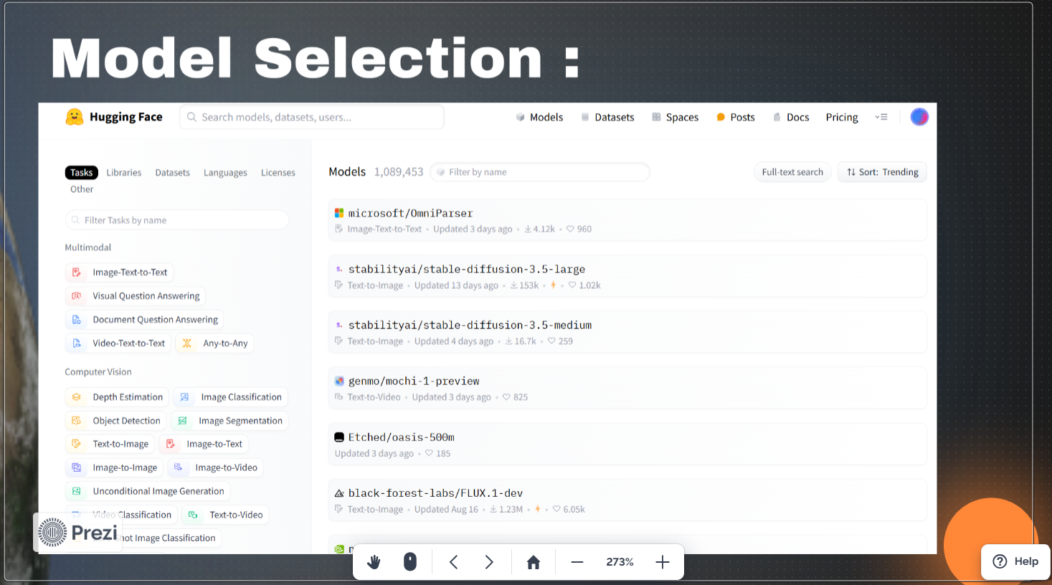
Problem Statement
As a data scientist at Microsoft, I was tasked with enhancing the efficiency of Security Operation Centers (SOCs) by developing a machine learning model that can accurately predict the triage grade of cybersecurity incidents. Utilizing the comprehensive GUIDE dataset, your goal is to create a classification model that categorizes incidents as true positive (TP), benign positive (BP), or false positive (FP) based on historical evidence and customer responses.
TP - A legitimate threat that is detected, BP - A legitimate activity or process that is sometimes mistaken for a malicious threat and FP - An alert that suggests a potential threat but is actually harmless
The model should be robust enough to support guided response systems in providing SOC analysts with precise, context-rich recommendations, ultimately improving the overall security posture of enterprise environments.

Slide 6
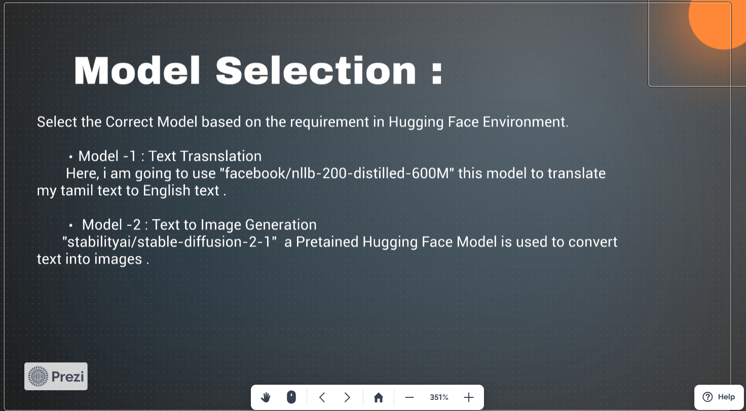
Problem Statement
As a data scientist at Microsoft, I was tasked with enhancing the efficiency of Security Operation Centers (SOCs) by developing a machine learning model that can accurately predict the triage grade of cybersecurity incidents. Utilizing the comprehensive GUIDE dataset, your goal is to create a classification model that categorizes incidents as true positive (TP), benign positive (BP), or false positive (FP) based on historical evidence and customer responses.
TP - A legitimate threat that is detected, BP - A legitimate activity or process that is sometimes mistaken for a malicious threat and FP - An alert that suggests a potential threat but is actually harmless
The model should be robust enough to support guided response systems in providing SOC analysts with precise, context-rich recommendations, ultimately improving the overall security posture of enterprise environments.

Slide 7
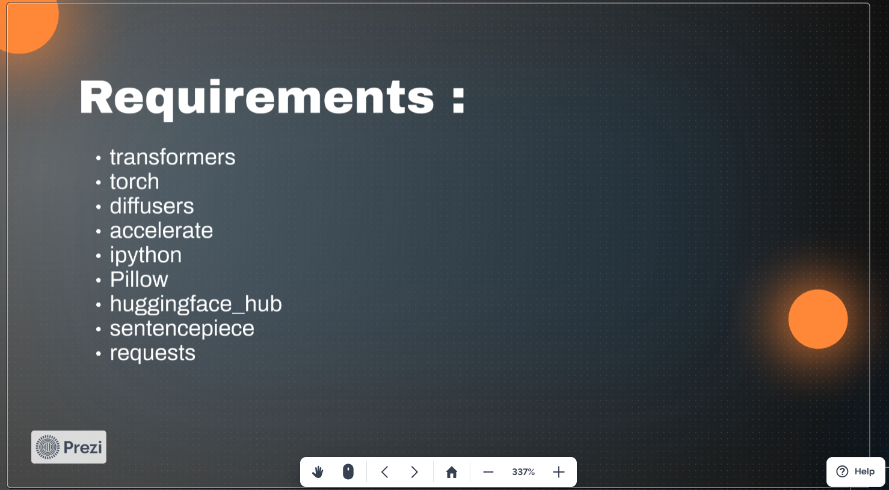
Problem Statement
As a data scientist at Microsoft, I was tasked with enhancing the efficiency of Security Operation Centers (SOCs) by developing a machine learning model that can accurately predict the triage grade of cybersecurity incidents. Utilizing the comprehensive GUIDE dataset, your goal is to create a classification model that categorizes incidents as true positive (TP), benign positive (BP), or false positive (FP) based on historical evidence and customer responses.
TP - A legitimate threat that is detected, BP - A legitimate activity or process that is sometimes mistaken for a malicious threat and FP - An alert that suggests a potential threat but is actually harmless
The model should be robust enough to support guided response systems in providing SOC analysts with precise, context-rich recommendations, ultimately improving the overall security posture of enterprise environments.

Slide 8
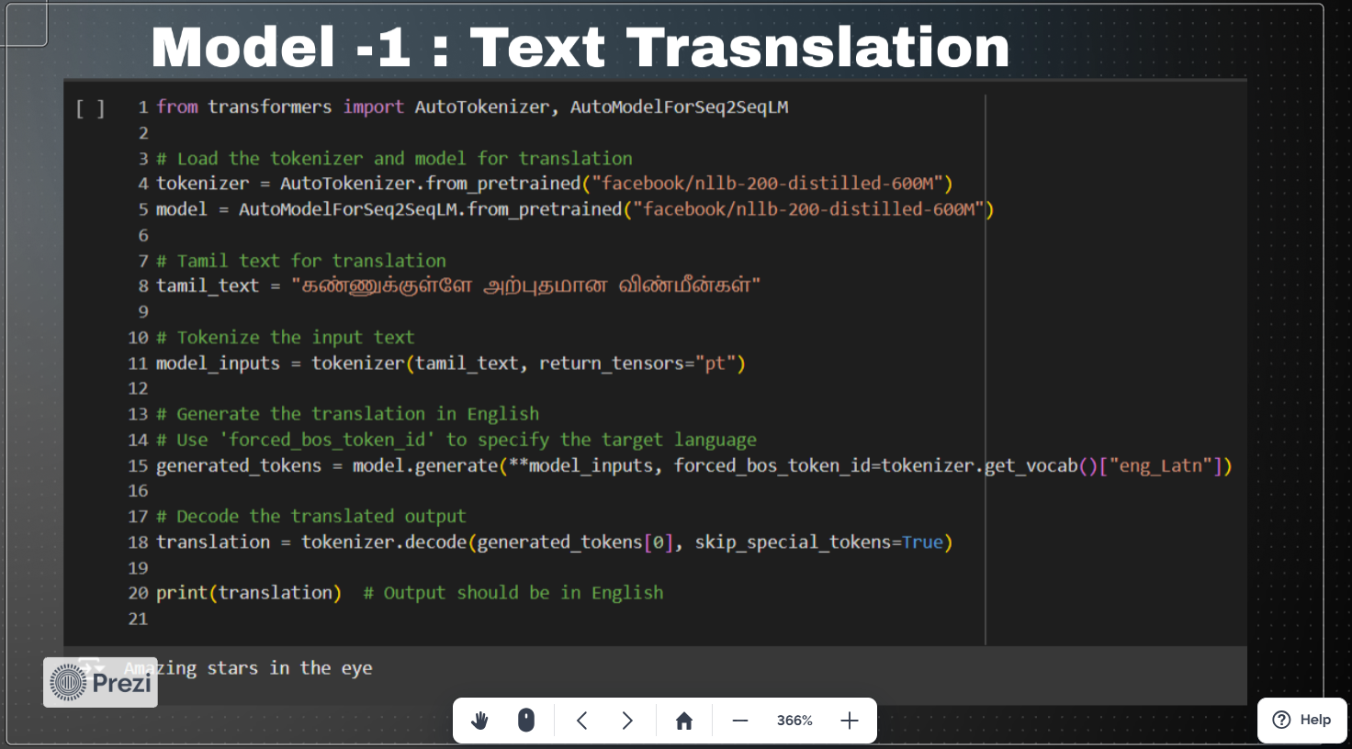
Problem Statement
As a data scientist at Microsoft, I was tasked with enhancing the efficiency of Security Operation Centers (SOCs) by developing a machine learning model that can accurately predict the triage grade of cybersecurity incidents. Utilizing the comprehensive GUIDE dataset, your goal is to create a classification model that categorizes incidents as true positive (TP), benign positive (BP), or false positive (FP) based on historical evidence and customer responses.
TP - A legitimate threat that is detected, BP - A legitimate activity or process that is sometimes mistaken for a malicious threat and FP - An alert that suggests a potential threat but is actually harmless
The model should be robust enough to support guided response systems in providing SOC analysts with precise, context-rich recommendations, ultimately improving the overall security posture of enterprise environments.

Slide 9
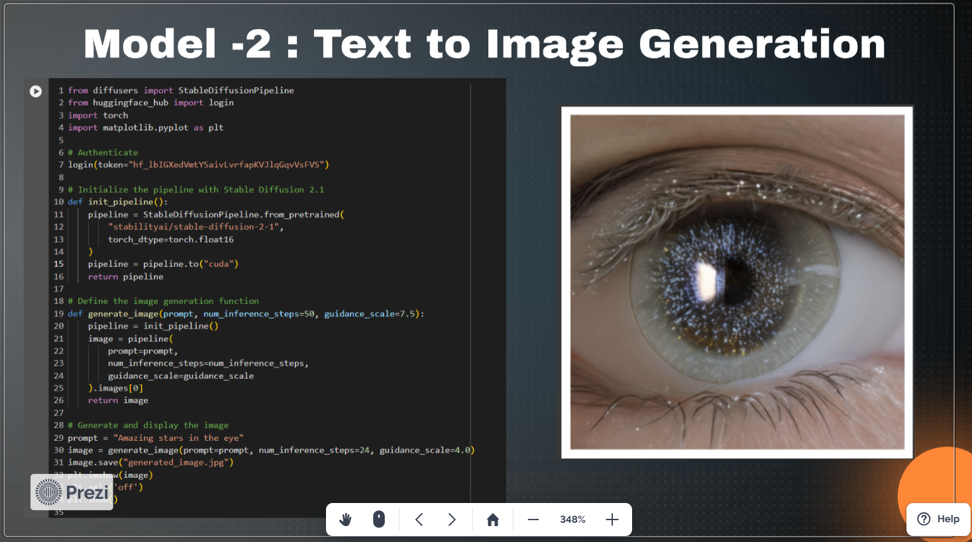
Problem Statement
As a data scientist at Microsoft, I was tasked with enhancing the efficiency of Security Operation Centers (SOCs) by developing a machine learning model that can accurately predict the triage grade of cybersecurity incidents. Utilizing the comprehensive GUIDE dataset, your goal is to create a classification model that categorizes incidents as true positive (TP), benign positive (BP), or false positive (FP) based on historical evidence and customer responses.
TP - A legitimate threat that is detected, BP - A legitimate activity or process that is sometimes mistaken for a malicious threat and FP - An alert that suggests a potential threat but is actually harmless
The model should be robust enough to support guided response systems in providing SOC analysts with precise, context-rich recommendations, ultimately improving the overall security posture of enterprise environments.

Slide 10
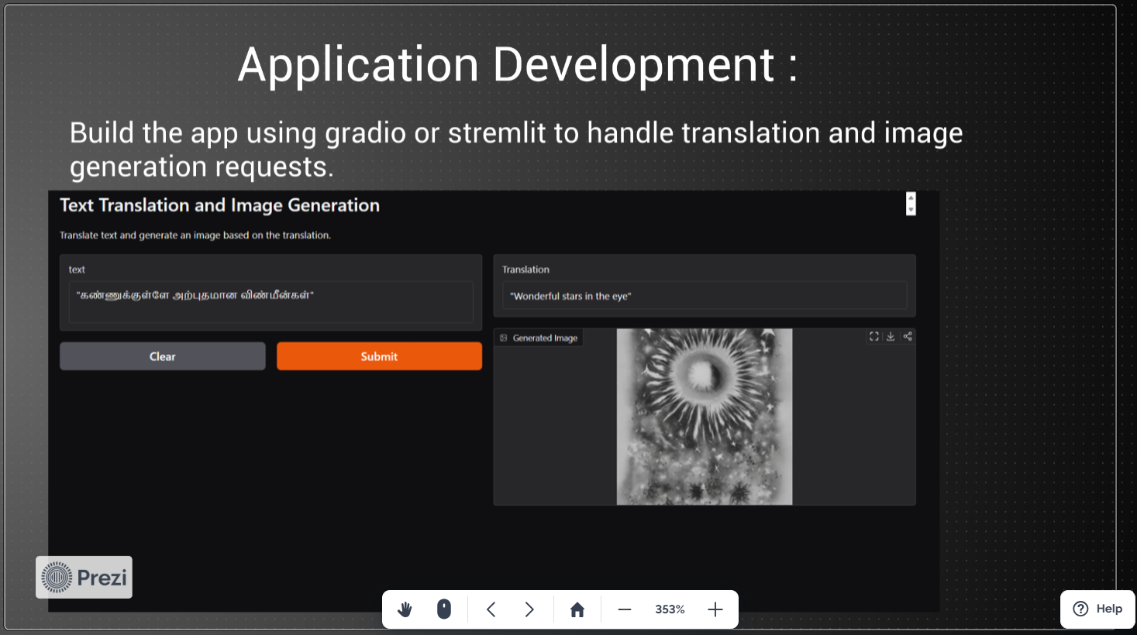
Problem Statement
As a data scientist at Microsoft, I was tasked with enhancing the efficiency of Security Operation Centers (SOCs) by developing a machine learning model that can accurately predict the triage grade of cybersecurity incidents. Utilizing the comprehensive GUIDE dataset, your goal is to create a classification model that categorizes incidents as true positive (TP), benign positive (BP), or false positive (FP) based on historical evidence and customer responses.
TP - A legitimate threat that is detected, BP - A legitimate activity or process that is sometimes mistaken for a malicious threat and FP - An alert that suggests a potential threat but is actually harmless
The model should be robust enough to support guided response systems in providing SOC analysts with precise, context-rich recommendations, ultimately improving the overall security posture of enterprise environments.

Slide 11
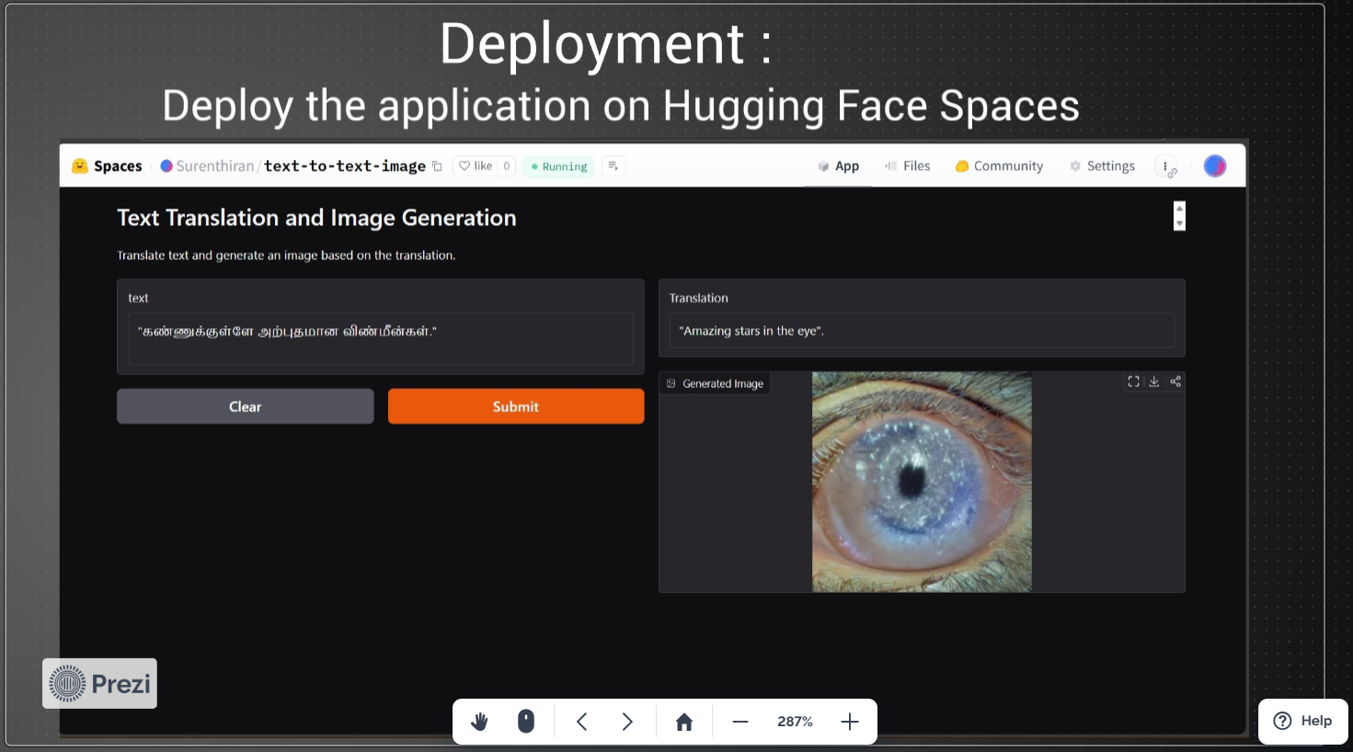
Problem Statement
As a data scientist at Microsoft, I was tasked with enhancing the efficiency of Security Operation Centers (SOCs) by developing a machine learning model that can accurately predict the triage grade of cybersecurity incidents. Utilizing the comprehensive GUIDE dataset, your goal is to create a classification model that categorizes incidents as true positive (TP), benign positive (BP), or false positive (FP) based on historical evidence and customer responses.
TP - A legitimate threat that is detected, BP - A legitimate activity or process that is sometimes mistaken for a malicious threat and FP - An alert that suggests a potential threat but is actually harmless
The model should be robust enough to support guided response systems in providing SOC analysts with precise, context-rich recommendations, ultimately improving the overall security posture of enterprise environments.

Slide 12
Problem Statement
As a data scientist at Microsoft, I was tasked with enhancing the efficiency of Security Operation Centers (SOCs) by developing a machine learning model that can accurately predict the triage grade of cybersecurity incidents. Utilizing the comprehensive GUIDE dataset, your goal is to create a classification model that categorizes incidents as true positive (TP), benign positive (BP), or false positive (FP) based on historical evidence and customer responses.
TP - A legitimate threat that is detected, BP - A legitimate activity or process that is sometimes mistaken for a malicious threat and FP - An alert that suggests a potential threat but is actually harmless
The model should be robust enough to support guided response systems in providing SOC analysts with precise, context-rich recommendations, ultimately improving the overall security posture of enterprise environments.

